Slide 1
4
The
Management
Environment

Slide 2
Learning Objectives
Describe the new economy and how it’s affecting the way organizations are managed
01
Explain globalization and its impact on organizations
02
Discuss how society’s expectations are influencing managers and organizations
03
Describe how the workforce is changing and its impact on the way organizations are managed
04
Discuss trust as the essence of leadership
05

Slide 3
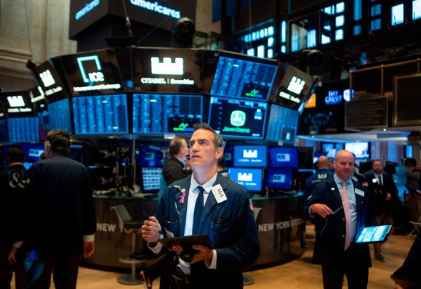
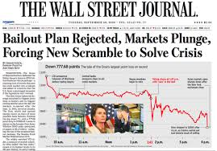
How Has the Economy Changed?
1980s
The U.S. economy was growing and tax rates were low
Low inflation and low interest rates fueled consumer spending
Individuals took risks by investing in the stock market, buying homes, and starting their own businesses
2008
Gas prices hit $4 plus per gallon
Adjustable mortgages adjusted upward with higher monthly payments due, many consumers couldn’t keep up
Notes:
You know the economic context has changed when you have a company like General Motors in bankruptcy, 9.4 million jobs vanishing in the United
States, and an economic vocabulary that includes terminology like toxic assets, collaterized debt obligations, TARP, bailouts, economic stabilization,
wraparound mortgages, and stress tests. To understand what this new economy is like, we need to look at the changes that have taken place and the impact of those changes on the way that organizations are managed.

Slide 4
The Economic Crisis
Began with turmoil in mortgage markets
Spread to businesses when broader credit markets collapsed
Called the worst since the Great Depression
Foreclosures, financial recession, a huge public debt, and widespread social problems from job losses signal that the U.S. and global economic environments have changed and are continuing to change
Notes:
This economic crisis, which began with turmoil in mortgage markets and spread to businesses when broader credit markets collapsed, has been called the worst since the Great Depression. With foreclosures, financial recession, a huge public debt, and widespread social problems from job losses, it’s clear that the U.S. and global economic environments have changed and are continuing to change. For instance, the International Monetary Fund forecasted that the global economy would likely contract in 2009 for the first time since World War II and that the recovery would take longer than expected

Slide 5
What Will the “New” Normal Be Like?
The New Normal
“Capitalism will be different” Timothy Geithner, the U.S. Secretary of the Treasury
Increased role of government, especially in financial markets
Government spending is now at levels not seen since World War Two
Public concerns about the growing budget deficit and increased government intervention in the economy.
Notes:
Experts believe that once the U.S. economy emerges from recession things won’t be the way they were—that there will be a “new” normal. As Timothy Geithner, the U.S. Secretary of the Treasury, said, “Capitalism will be different.”10 How managers manage and the way
businesses operate will not be as they’ve always been. The biggest change is likely to be in the role of government, especially in financial markets and in consumer protection

Slide 6
Technology and the Manager’s Job
Continuing advances in technology make work more efficient and improve available information and communication
Technology
Any equipment, tools, or operating methods that are designed to make work more efficient
Intranet
A private computer network that uses Internet technology and is accessible only to organizational members
Notes:
One area where technology has had an impact is in the process where inputs (labor, raw materials, and the like) are
transformed into outputs (goods and services to be sold).
Information technology (IT) has created the ability to circumvent the physical confines of working only in a specified organizational location.
Technology is also changing the way managers manage, especially in terms of how they interact with employees who
may be working anywhere and anytime

Slide 7
What Is Globalization and How Does It Affect Organizations?
Global Village
The concept of a boundaryless world where goods and services are produced and marketed worldwide
Multinational Corporation (MNC)
Any type of international company that maintains operations in multiple countries.
Multidomestic Corporation
An MNC that decentralizes management and other decisions to the local country where it’s doing business.
Notes:
Over the last couple of decades, we’ve seen an explosion of companies operating almost anywhere in the world. National borders mean little when it comes to doing business. Avon, a so-called American company, gets 81 percent of its annual revenues from sales outside the United States. BMW, a German owned firm, builds cars in South Carolina. McDonald’s sells hamburgers in China.

Slide 8
Other Types of Global Organizations
Global Corporation
An MNC that centralizes management and other decisions in the home country
Transnational (Borderless) Organization
A structural arrangement for global organizations that eliminates artificial geographical barriers.
Notes:
MNCs are any type of international company that maintains operations in multiple countries. Today, companies such as Procter &
Gamble, Wal-Mart, Exxon, Coca-Cola, and Aflac are among a growing number of U.S.-based firms that get significant portions of their annual revenues from foreign operations.

Slide 9
How Do Organizations Go Global?
Global Sourcing
Purchasing materials or labor from around the world wherever it is cheapest
Exporting
Making products domestically and selling them abroad
Importing
Acquiring products made abroad and selling them domestically
Notes:
When organizations do go global, they often use different approaches. At first, managers want to get into a global market
with minimal investment. At this stage, they may start with global sourcing. The next step in going global may involve exporting the organization’s products to other countries. In addition, an organization might do importing, which involves acquiring products made abroad and selling them domestically.

Slide 10
Going Global (cont.)
Licensing
An agreement primarily used by manufacturing businesses in which an organization gives another the right, for a fee, to make or sell its products, using its technology or product specifications
Franchising
An agreement primarily used by service businesses in which an organization gives another organization the right, for a fee, to use importing its name and operating methods
Notes:
Finally, managers might use licensing or franchising, which are similar approaches involving one organization giving another organization the right to use its brand name, technology, or product specifications in return for a lump sum payment or a fee usually based on sales. The only difference is that licensing is primarily used by manufacturing organizations that make or sell another company’s products, and franchising is primarily used by service organizations that want to use another company’s name and operating methods

Slide 11
Going Global (cont.)
Global Strategic Alliance
A partnership between an organization and a foreign company partner(s) in which resources and knowledge are shared in developing new products or building production facilities
Joint Venture
A specific type of strategic alliance in which the partners agree to form a separate, independent organization for some business purpose
Notes:
Once an organization has been doing business internationally for a while and has gained experience
in international markets, managers may decide to make more of a direct investment. One way to do this is
through a global strategic alliance, which is a partnership between an organization and a foreign company
partner or partners in which both share resources and knowledge in developing new products or building
production facilities.
A specific type of strategic alliance in which the partners form a separate, independent organization for some business purpose is called a joint venture.

Slide 12
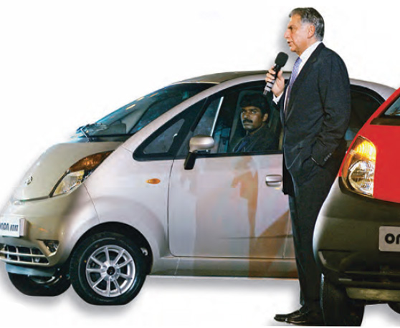
Going Global (cont.)
Foreign Subsidiary
A direct investment in a foreign country that involves setting up a separate and independent facility or office
Notes:
Finally, managers may choose to directly invest in a foreign country by setting up a foreign subsidiary as a separate and independent facility or office. This subsidiary can be managed as a multidomestic organization (local control) or as a global organization
(centralized control).

Slide 13
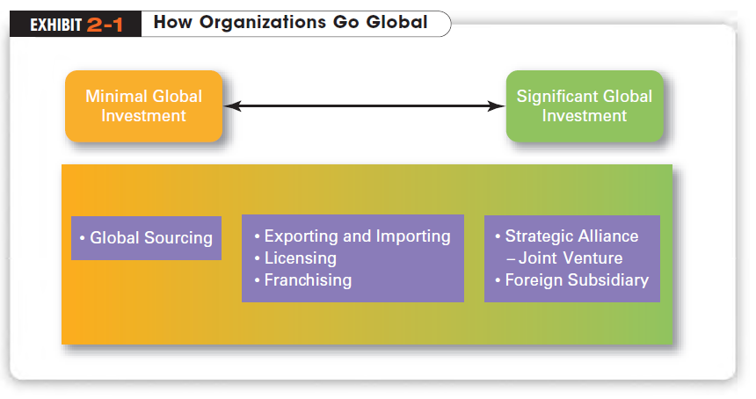
Notes:
When organizations do go global, they often use different approaches.

Slide 14
What Do Managers Need to Know?
Parochialism
A narrow focus in which managers see things only through their own eyes and from their own perspective
All countries have different values, morals, customs, political and economic systems, and laws, all of which can affect how a business is managed
Notes:
U.S. managers once held (and some still do hold) a rather parochial view of the world of business. Parochialism is a narrow focus in which managers see things only through their own eyes and from their own perspectives. They don’t recognize that people from other countries have different ways of doing things or that they live differently from Americans.

Slide 15
Hofstede’s Framework
Geert Hofstede
Studied differences in culture and found that managers and employees vary on five value dimensions of national culture:
Power Distance
Individualism vs. Collectivism
Achievement vs. Nurturing
Uncertainty Avoidance
Long-term vs. Short-term Orientation
Notes:
Geert Hofstede’s framework is one of the most widely referenced approaches for analyzing cultural variations. His work has had a major impact on
what we know about cultural differences among countries

Slide 16
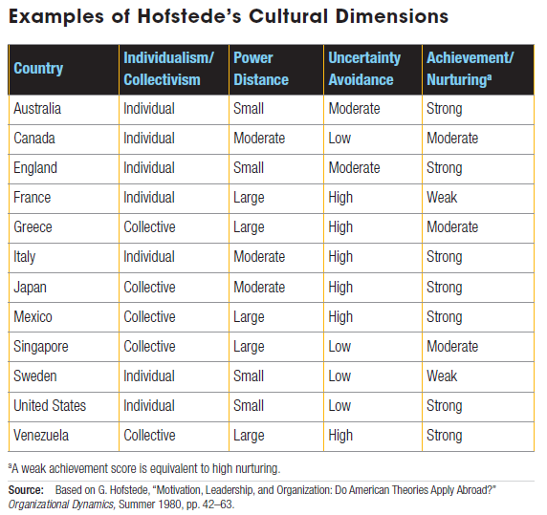

Slide 17
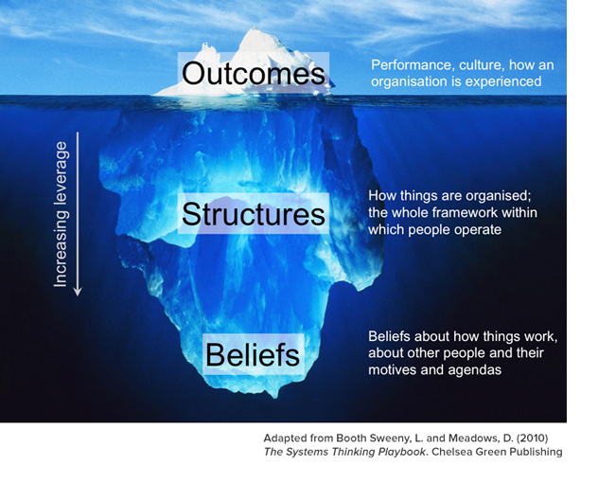
Edward Hall’s Iceberg Theory
Notes:
The culture can be divided into surface level which is easily visible, deep level that is not visible. Surface level include appearance, mannerism, language etc. The deep level culture is made of values and beliefs.

Slide 18
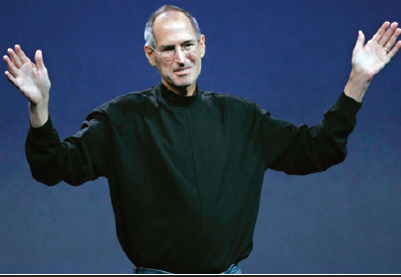
What Does Society Expect from Organizations and Managers?
Green Management
When managers recognize and consider the impact of their organization and its practices on the natural environment
The idea of being environmentally friendly or green affects many aspects of business
Notes:
One area where many organizations have become more socially involved is green management, which is when managers recognize and consider the impact of their organization and its practices on the natural environment

Slide 19
How Can Organizations Demonstrate Socially Responsible Actions?
Social Responsibility
A business firm’s intention, beyond its legal and economic obligations, to do the right things and act in ways that are good for society
Social Obligation
When a business firm engages in social actions because of its obligation to meet certain economic and legal responsibilities
Social Responsiveness
When a business firm engages in social actions in response to some popular social need
Notes:
When we talk about social responsibility, we mean a business firm’s intention, beyond its legal and economic obligations, to do the right things and act in ways that are good for society. Note that this definition assumes that a business obeys the law and pursues economic interests. But also note that this definition views a business as a moral agent. In its effort to do good for society, it must differentiate between right and wrong.

Slide 20
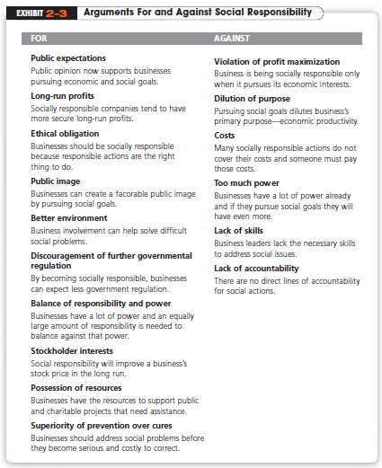

Slide 21
How Can Managers Become More Ethical?
Ethics
Commonly refers to a set of rules or principles that defines right and wrong conduct
Code of Ethics
A formal document that states an organization’s primary values and the ethical rules it expects managers and nonmanagerial employees to follow
Notes:
Ethics commonly refers to a set of rules or principles that defines right and wrong conduct. Right or wrong behavior, though, may at times be difficult to determine. Most recognize that something illegal is also unethical.

Slide 22
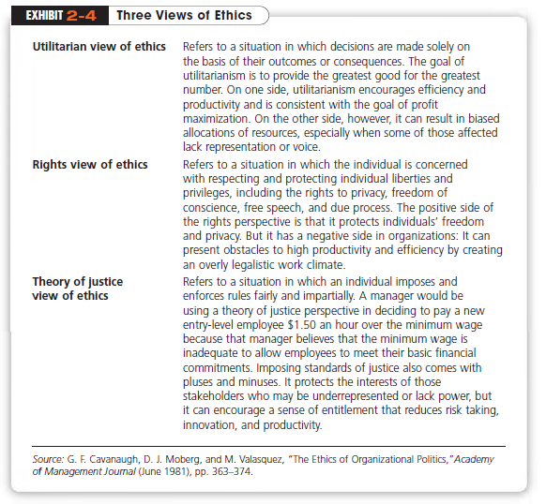
Notes:
Exhibit 2-4 presents three views of ethical standards. Regardless of which view you think is most appropriate, whether a manager acts ethically or unethically will depend on several factors. These factors include an individual’s morality, values, personality, and experiences; the organization’s culture; and the ethical issue being faced.

Slide 23
How Does Today’s Workforce Impact the Way We Manage?
Workforce Diversity
Ways in which people in a workforce are similar and different from one another in terms of
Gender
Age
Race
Sexual Orientation
Ethnicity
Cultural Background
Physical Abilities and Disabilities
Notes:
An important challenge facing today’s organizations is adapting to a diverse workforce. Workforce diversity refers to ways in which people in a workforce are similar and different from one another in terms of gender, age, race, sexual orientation, ethnicity, cultural background, and physical abilities and disabilities.
Until recently, organizations took a “melting pot” approach to diversity. It was assumed that people who were different would somehow automatically want to assimilate. But today’s managers find that employees do not set aside their cultural values and lifestyle preferences when they come to work

Slide 24
What Does the Workforce Look Like Today?
Those born before 1946 - 6 percent of the workforce
Baby boomers , born between 1946 and 1964 - 41.5 percent of the workforce
Generation X, born 1965 to 1977 - 29 percent of the workforce
Gen Y , born 1978 to 1994 - 24 percent of the workforce.
Notes:
Much of the change in the U.S. workforce over the last 50 years can be attributed to federal legislation enacted in the 1960s that prohibited employment discrimination. With these laws, avenues opened up for minority and female job applicants. These two groups dramatically changed the workplace in the latter half of the twentieth century. Women, in particular, have changed the composition of the workforce as they now hold some 49.1 percent of jobs

Slide 25
How Are Managers Adapting to a Changing Workforce?
Family-Friendly Benefits
Benefits that provide a wide range of scheduling options that allow employees more flexibility at work, accommodating their needs for work/life balance
Contingent Workforce
Part-time, temporary, and contract workers who are available for hire on an as-needed basis
Notes:
Today’s progressive workplaces must accommodate the varied needs of a diverse workforce. In response, many organizations are offering family-friendly benefits, benefits that provide a wide range of scheduling options that allow employees more flexibility at work, accommodating their need for work/life balance.

Slide 26
Can Organizations Improve Customer Service?
Creating a Customer –Responsive Culture
Type of employee (friendly, outgoing)
Employees need freedom to meet changing customer-service requirements
Employees must be empowered with decision discretion
Employees must be good listeners
Notes:
The majority of employees today in developed countries work in service jobs. And because an organization can’t exist without customers,
management needs to ensure that employees do what it takes to please its customers

Slide 27
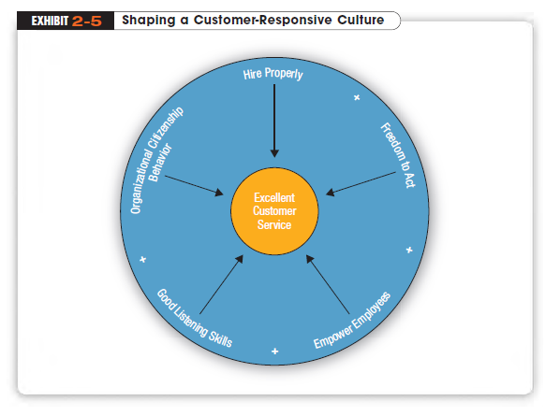
Notes:
As shown in Exhibit 2-5, customer-responsive cultures routinely have several variables.

Slide 28
How Can Organizations Improve Quality?
Continuous Improvement
An organization’s commitment to continually improving the quality of a product or service
Kaizen
The Japanese term for an organization’s commitment to continuous improvement
Work Process Engineering
Radical or quantum change in an organization.
Notes:
The generic term that has evolved to describe this pursuit of quality is quality management or continuous improvement. The revolution was inspired by a small group of quality experts, individuals such as the late Joseph Juran and the late W. Edwards Deming.

Slide 29
